Slide 1

E- Commerce
PROF SWATI SHARMA
TULAS INSTITUTE

Slide 2
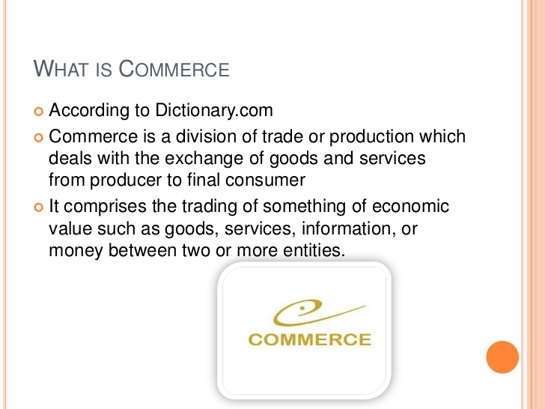

Slide 3
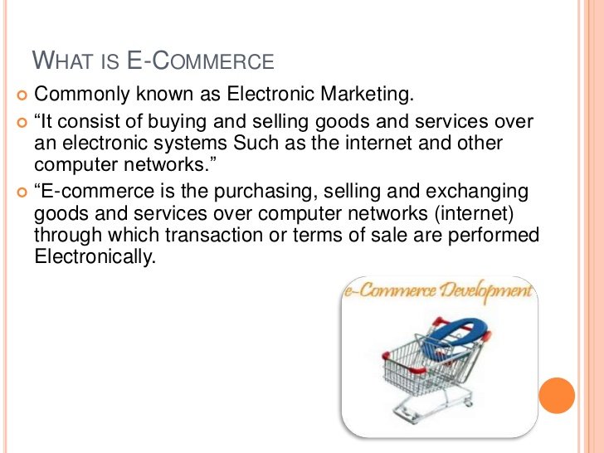

Slide 4
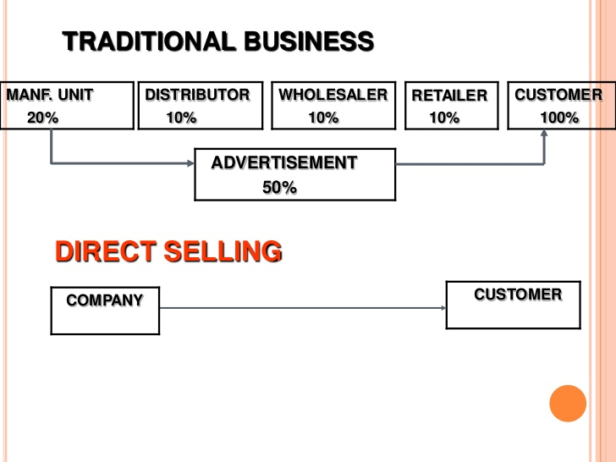

Slide 5
LETS ANSWER
1.WHAT IS TRADING?
BUYING AND SELLING OF GOODS AND SERVICES FOR PROFIT
2. COMPARE COMMERCE AND E-COMMERCE
COMMERCE IS TRADING OF GOODS AND SERVICES FROM PRODUCER TO
FINAL CONSUMER
E-COMMERCE IS TRADING OF GOODS AND SERVICES ELECTRONICALLY I.E
OVER INTERNET.
3. EXPLAIN WHAT IS ECONOMIC VALUE?
FINANCIAL VALUE ATTACHED WITH A PRODUCT OR SERVICE WHICH IS
ADDED TO EXPLAIN THE UTILITY OF THAT PRODUCT OR ERVICE.
ANYTHING FOR WHICH WE HAVE TO GIVE MONEY
4.WHAT COMES UNDER ENTITITIES .???
ORGANISATION,BUSINESS,CUSTOMER,EMPLOYEE.

Slide 6
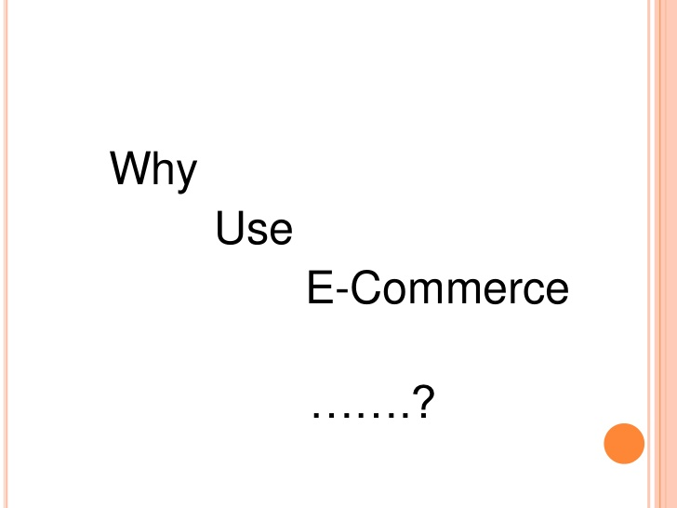

Slide 7
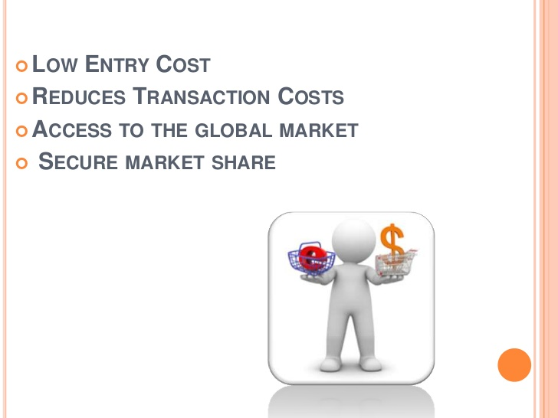

Slide 8
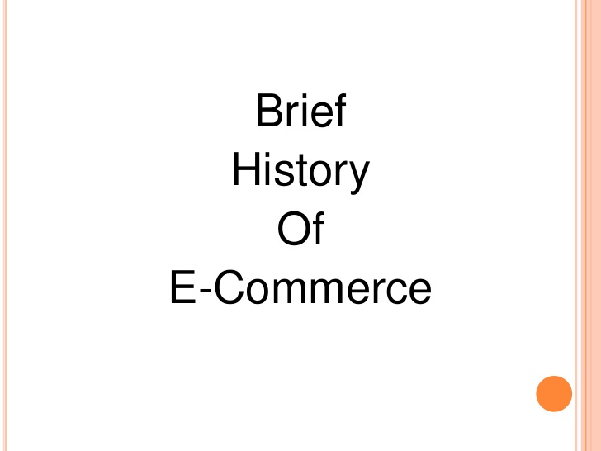

Slide 9
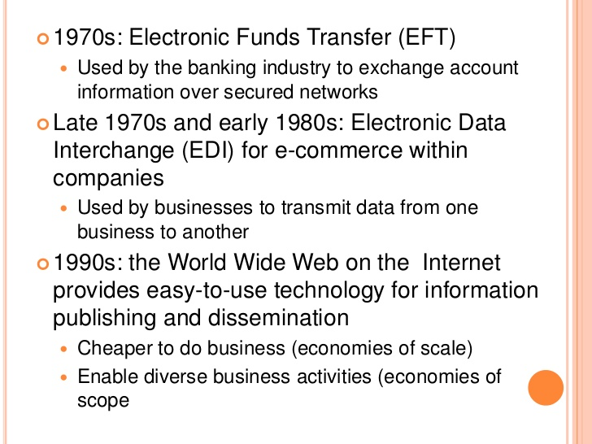

Slide 10
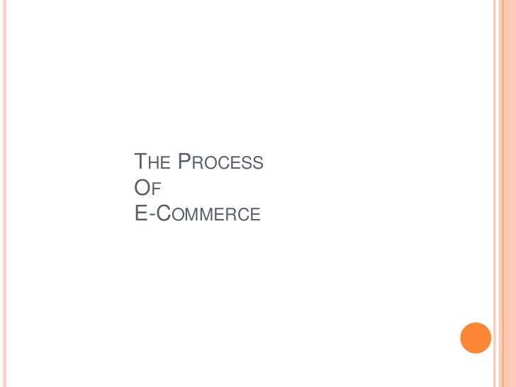

Slide 11
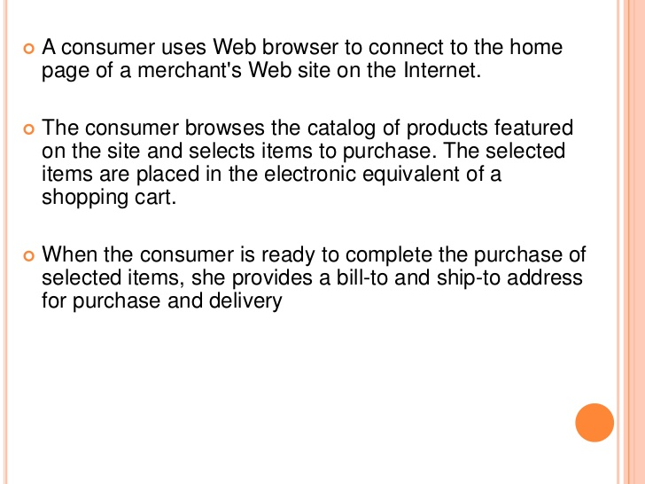

Slide 12
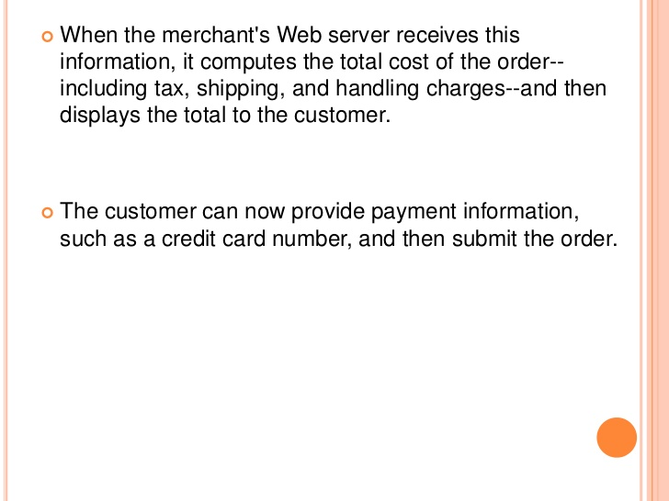

Slide 13
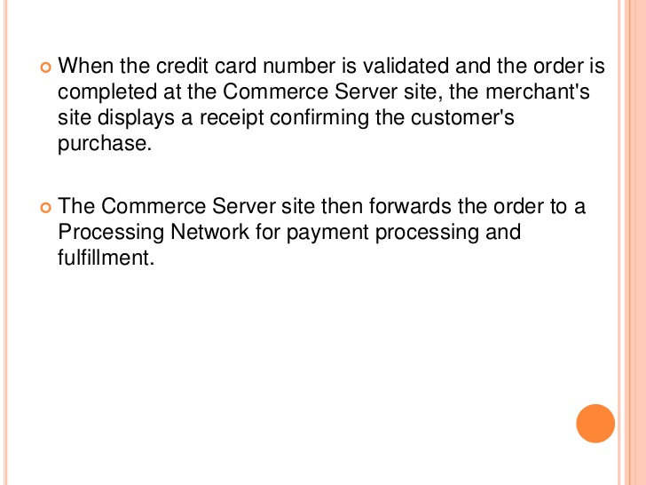

Slide 14
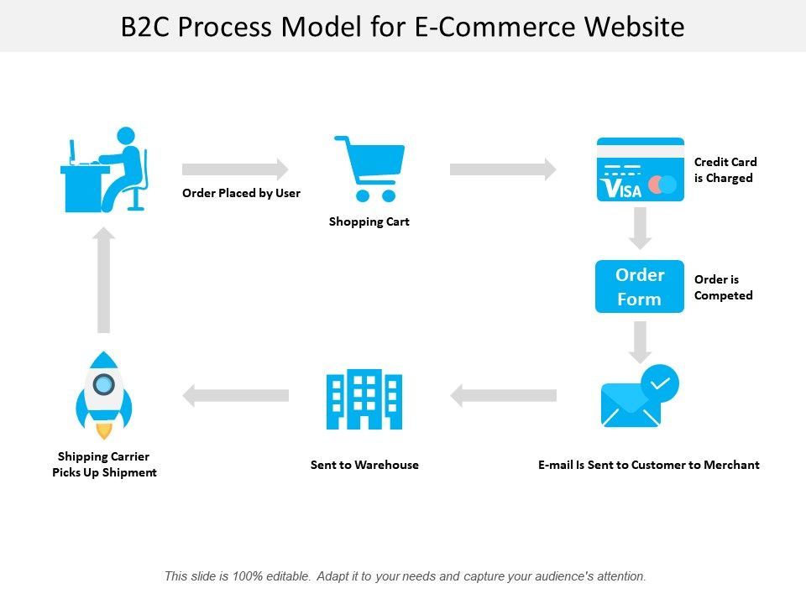

Slide 15
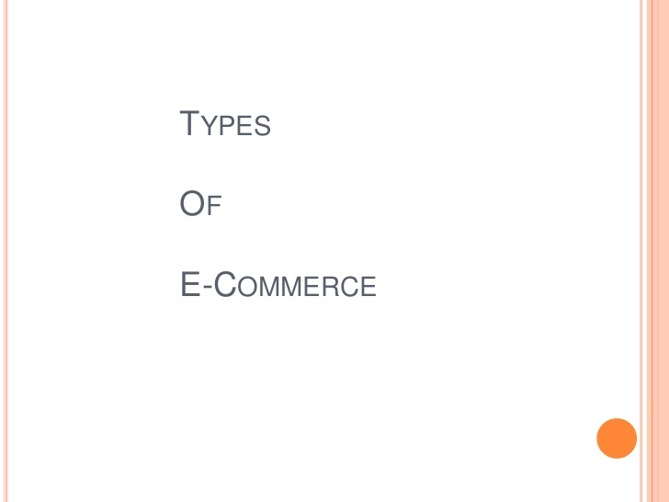

Slide 16
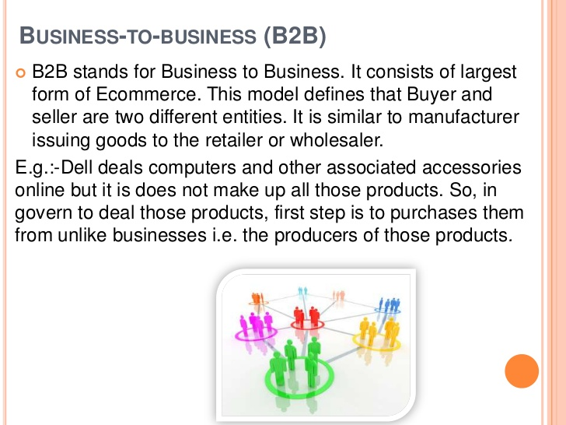

Slide 17
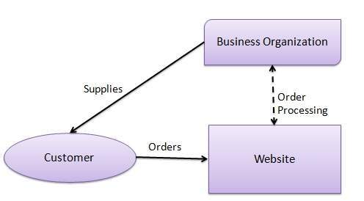

Slide 18
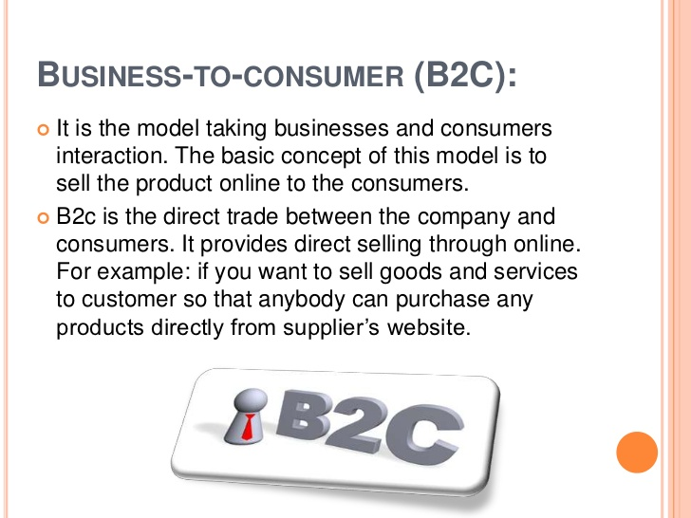

Slide 19
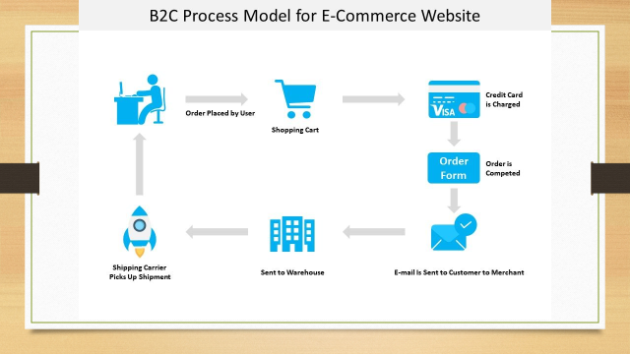

Slide 20
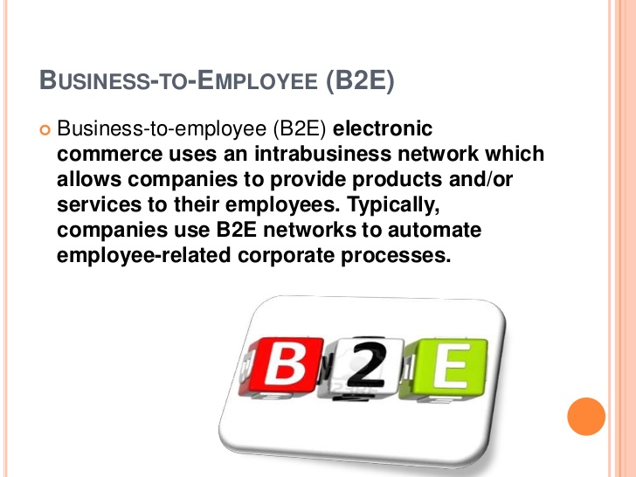

Slide 21
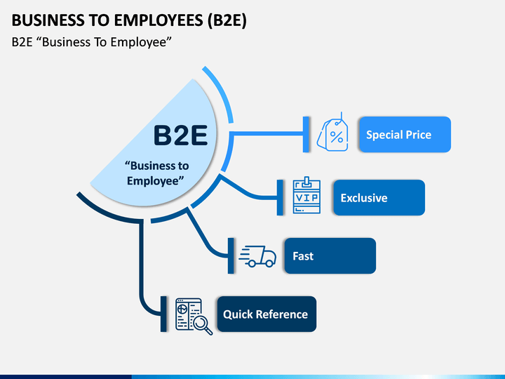

Slide 22
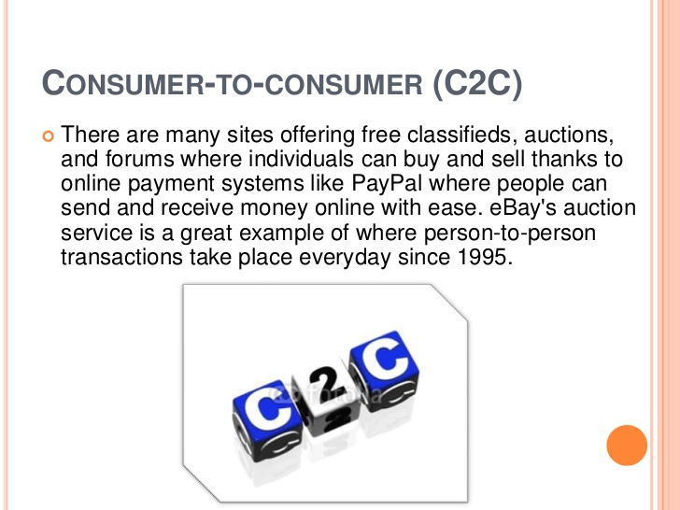

Slide 23
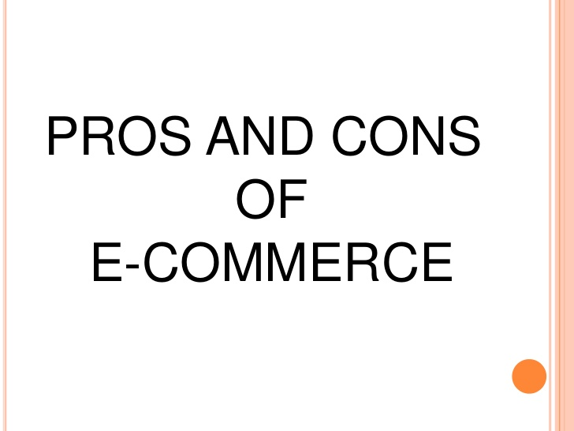

Slide 24


Slide 25
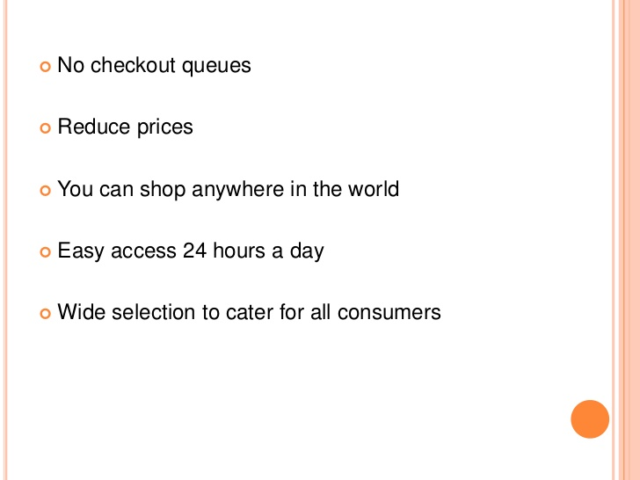

Slide 26


Slide 27
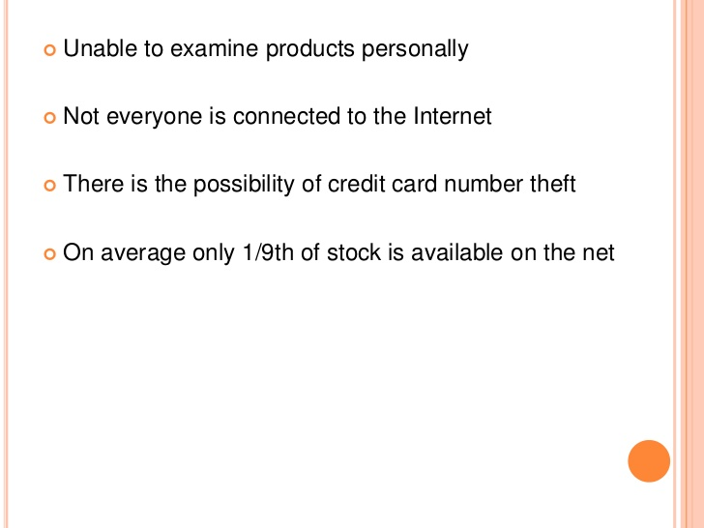

Slide 28
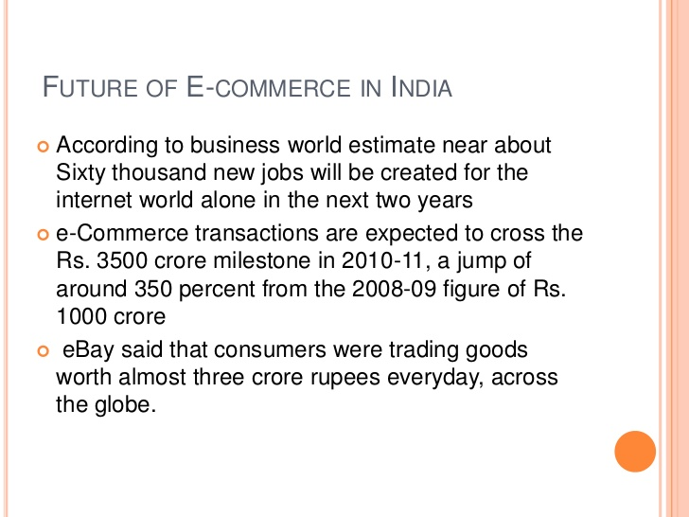

Slide 29
ASSIGNMENTS- SUBMIT BY 12 APR
DEFINE
RTGS
IMPS
NEFT
DIFFERNTIATE BETWEEN THE THREE WITH THE HELP OF
GRAPHICS.
SHOW THE PROCESS OF ECOMMERCE WITH THE HELP OF DIAGRAM
WHAT ARE THE DIFFERENT TYPES OF E- COMMERCE?
POINT OUT THE ADVANTAGES AND DISADVANTAGES IF USING E-COMMERCE.
DISCUSS THE FUTURE OF E COMMERCE.

Slide 30


